Slide 1
Shiny Dashboard Project (Business Analytics)
Ahmad Hathim bin Ahmad Azman (P153146)
Hazim Fitri Bin Ahmad Faudzi (P152419)

Slide 2
Brief Description
This dashboard will allow users to analyze stock market data using data from the past 25 years and provide insight on time series analysis of the selected stock.
This data was sourced from Yahoo Finance using the `yfR` package. The data is then converted to monthly data and analyzed using the ARIMA and TBATS algorithms.
There are 2 main panels for the dashboard, and one side panel for interaction.
The side panel :
Allows user to select ticker to analyze.
Select algorithm preferred (ARIMA vs TBATS).
Select date range for visualization.
Select how many months ahead to forecast.
It also has a short guide on terms used and on how to select which algorithm.
The main panel (1):
Shows the time series plot of the stock
Shows the time series plot of the volume of trade.
The main panel (2):
Shows the yearly Seasonal decomposition of the time-series analysis.
Shows the Trend decomposition of the time-series analysis for the past 25 years.

Slide 3
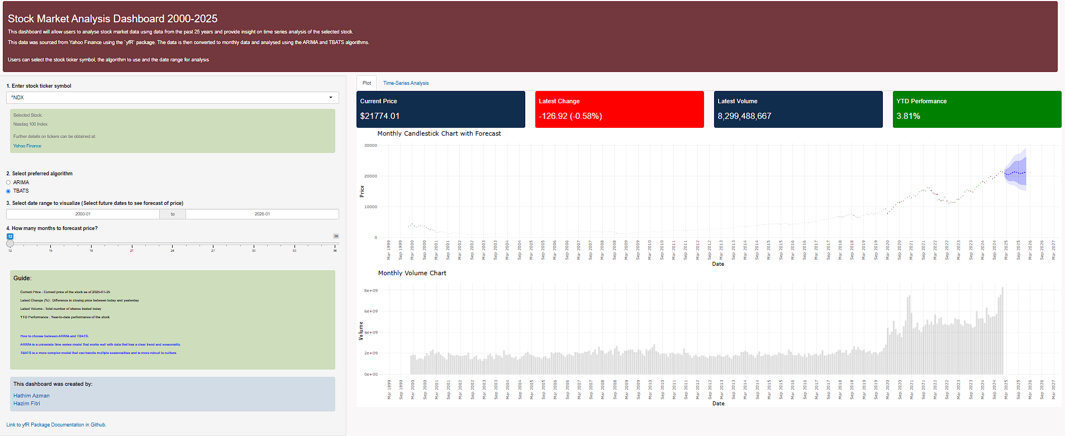

Slide 4
